Slide 1
Mobile App Development (MAD)
Teaching Team:
Mr Teo Wen Qiang, Wesley
Mr Low Kheng Hian, Ben

Slide 2
Intro to Android
Android Design Pattern
Intro to Event-driven Programming
Summary

Slide 3
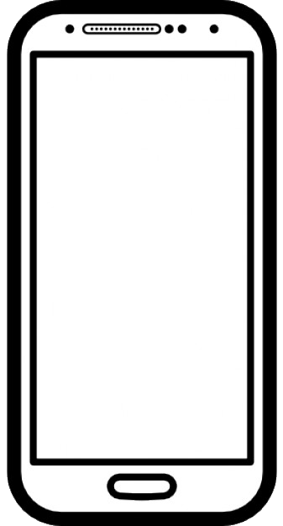
Introduction to Android

Slide 4


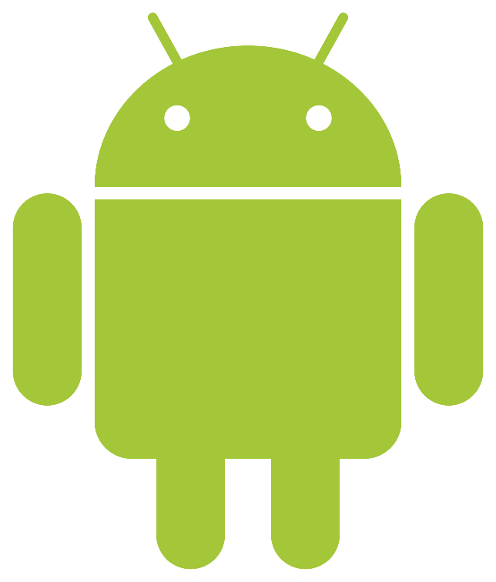
What is Android?
Is a mobile operating system primarily for mobile devices
Over 2 Billion users and over 87.5% of smartphone OS market share.
Notes:
Android is the world’s most popular and dominant mobile operating system.
It is based on Linux kernel 3.4/3.10 (depending on device) and is open-source (with proprietary bits).
It runs on a wide variety of hardware, including smartphones, smart watches, cars, televisions, digital cameras, game consoles and more.
It was founded by Andy Rubin and three others in October 2003 and got acquired by Google in August 2005.
Over 2B users
Over 3M apps available
Over 87.5% smartphone operating system market share
Thousands of third party libraries available
Free SDK, IDE and emulator
No restrictions; access anything
Faster access to new form factors and hardware
Distribute your app anywhere (Playstore, Amazon Appstore & etc)
https://en.wikipedia.org/wiki/Android_(operating_system)#Market_share
Caa 23 march 2021

Slide 5
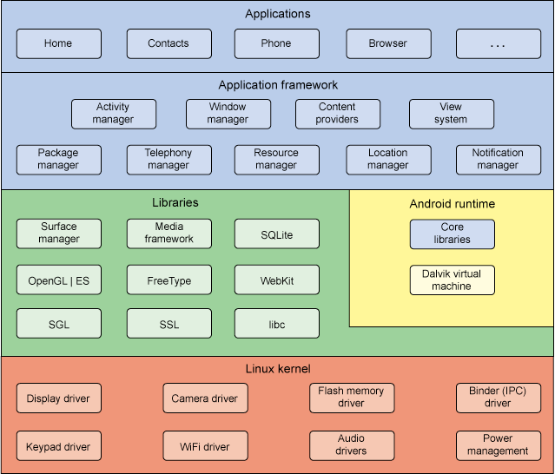
Software Stack
Modified version of Linux kernel
Middleware, libraries, APIs written in C
Apps run on application framework
Android Runtime (ART) as its runtime environment
Programming Language supported
Java, C, C++, Go (limited), Kotlin

Slide 6
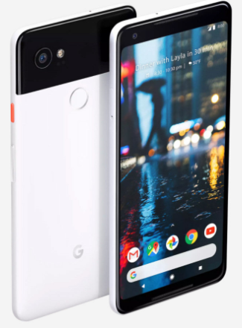
Hardware Requirements
Min hardware requirements to be certified by Google
Certified devices have Google services
E.g.
Android Handheld devices must have physical diagonal screen size 2.5 to 8 inches
Notes:
https://source.android.com/compatibility/android-cdd

Slide 7
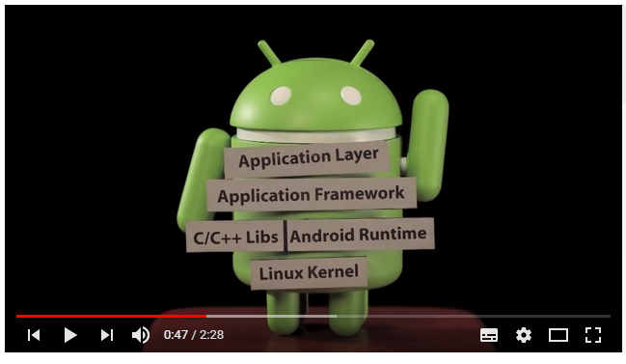
Video
https://youtu.be/Buo7kzHECHk (Stop at 1:00)

Slide 8
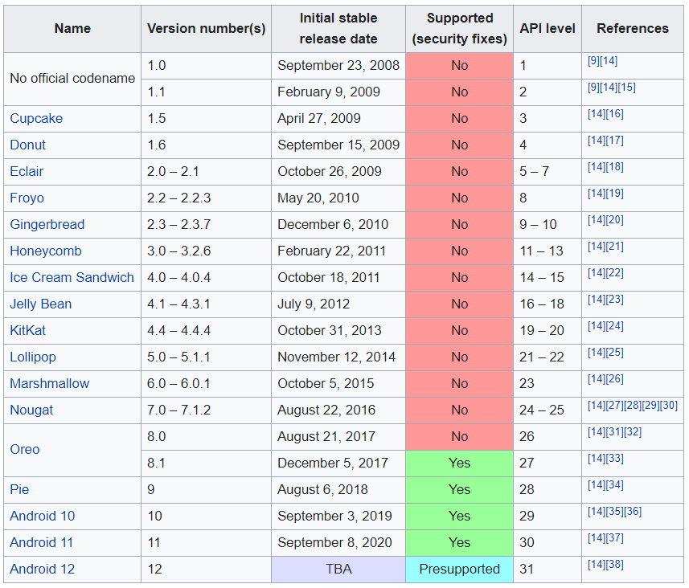
Code name, Version, API level
Notes:
https://en.wikipedia.org/wiki/Android_version_history

Slide 9
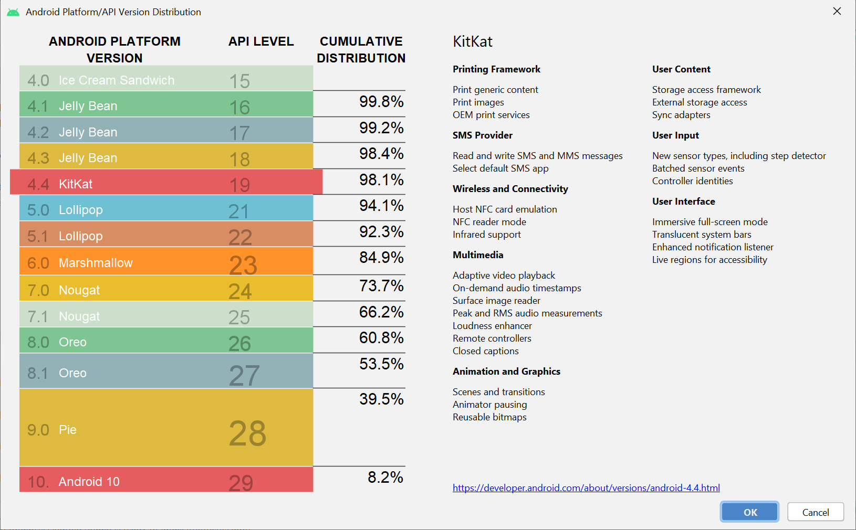
API Version Distribution
Notes:
https://developer.android.com/about/dashboards/index.html

Slide 10
Android Design Pattern

Slide 11
Android Design Pattern
A way to write source codes
Improve code maintainability and testability
Common design pattern for Android apps
Model-View-Controller (MVC)
Model-View-Presenter (MVP)
Model-View-ViewModel (MVVM)
As a taster to design pattern, we will use MVC in this module
Notes:
https://academy.realm.io/posts/eric-maxwell-mvc-mvp-and-mvvm-on-android/
https://www.spaceotechnologies.com/mvp-android-architectural-pattern/
https://www.vogella.com/tutorials/AndroidArchitecture/article.html

Slide 12
Model-View-Controller (MVC)
Model
contains Data, state, business logic (algorithm)
Reusable
View
Graphical User Interface
Controller
Glue that joins View and Model
Decides how to responds to click from View, and interact with Model
Notes:
https://en.wikipedia.org/wiki/Model%E2%80%93view%E2%80%93controller

Slide 13
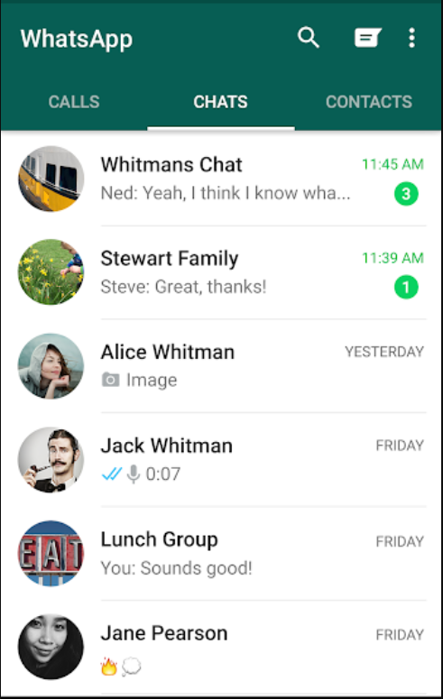
MVC in Codes
Resources, Widgets, and Layouts (*.xml)
Activity, Fragment & Adapter
Entities, Classes, Models
View
Controller
Model

Slide 14
Event driven Programming

Slide 15
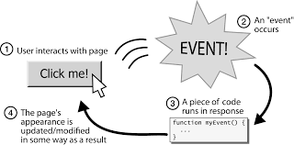
What is Event-driven Programming
In Python, the computer runs the code from the start, and terminates once it reaches the last line
In Android, Code segment runs as and when triggered by user actions, sensor outputs, or triggers from other programs
Dominant programming paradigm in GUI (e.g. website, desktop applications) and device drivers
The application software is designed to react to events
Notes:
https://en.wikipedia.org/wiki/Event-driven_programming

Slide 16
Summary
Introduction to Android
Versions of Android and its API level
Software stack
Android Design Pattern (MVC)
Event driven programming

